Slide 1
Tomasilong
Umbrellas are for sharing.
Garces, Zishran Julbert

Slide 2
Rationale
The Philippines is composed of only two seasons, rainy days and sunny days. Both of the two tropical seasons can sometimes be harsh on the people who live there. One of the protections used in these harsh environments are umbrellas.
In UST, some problems of the students are forgetting umbrellas at home, not having enough money to buy umbrellas, and umbrella theft. To solve these phenomenons, we propose an application that works like Grab Car but for umbrellas. This will allow students to share their umbrellas. This app will make the Thomasian community closer and lessen the threat of umbrella theft.
The app can only be used in the campus because it may be utilized for crime outside the premises of the University.

Slide 3
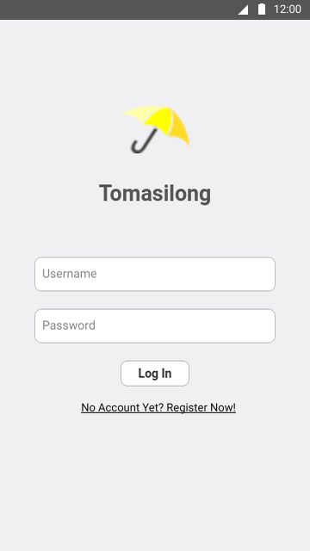
Login
The Tomasilong login interface allows the user to login, enter username and password, or create a new account.

Slide 4
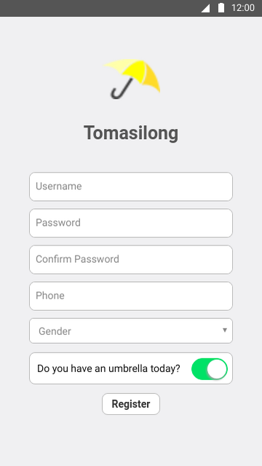
Register
Register account allows the user to register an account to use the application.

Slide 5
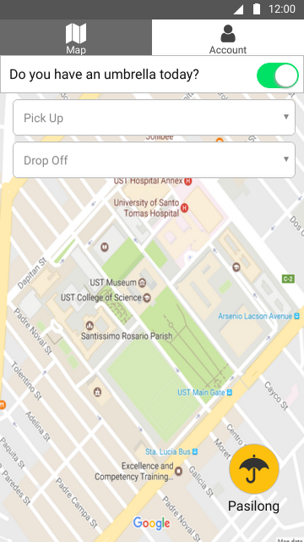
Map
The homepage displays the map of UST and display users within the campus who has an umbrella.

Slide 6
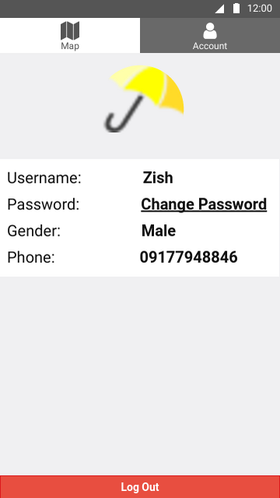
Account
The Accounts page displays the user’s account information and allows the user to log out.

Slide 7
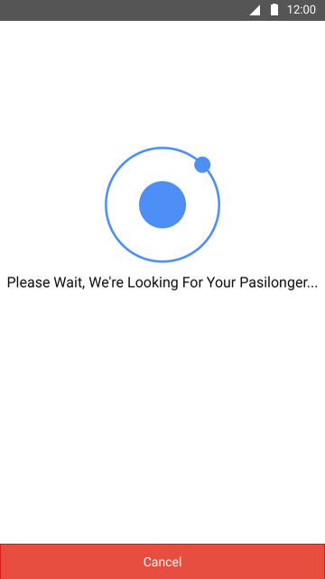
Find Someone Who Will Share Umbrella
This loading page appears after the user taps the Pasilong button.

Slide 8
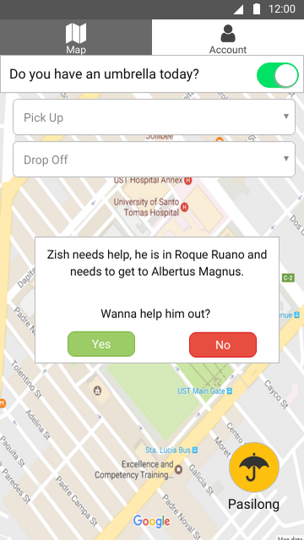
Notify That Someone Needs Umbrella
A notification appears if a user needs an umbrella.

Slide 9
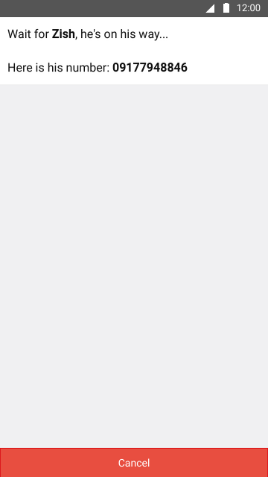
Wait For The Person Who Will Share Umbrella
This page appears after another user accepts the notification sent which asks for an umbrella.

Slide 10
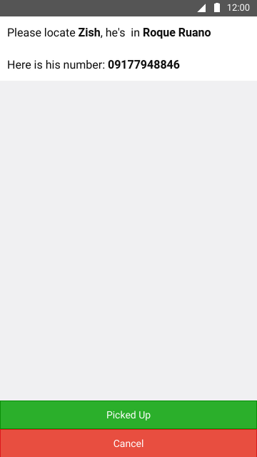
Find and Pick-Up
This page appears after the user accepts a notification sent by another user asking for an umbrella.

Slide 11
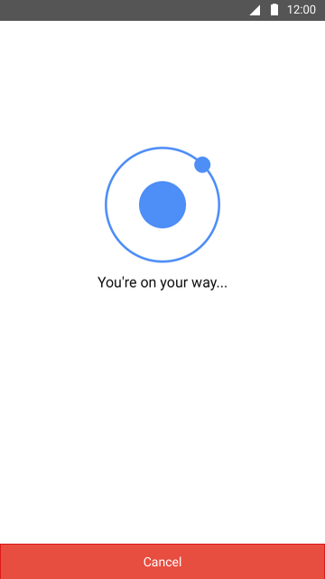
On The Way - Nakikisilong
This loading page appears when the Nagpapasilong has already picked up the Nakikisilong and both users are on their way to their destination.

Slide 12
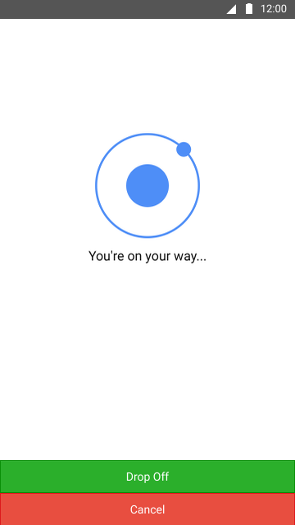
On The Way - Nagpapasilong
This loading page appears when the Nagpapasilong has already picked up the Nakikisilong and both users are on their way to their destination. The Drop Off button indicates that the Nakikisilong has been dropped off to his/her destination

